Slide 1
Hidden Linux Metrics with ebpf_exporter
Ivan Babrou
Notes:
Hello! My name is Ivan and today I’m going to talk about an exporter we wrote.

Slide 2
@ibobrik
Performance team @Cloudflare
Notes:
I work for a company called Cloudflare, where I focus on performance and efficiency of our products.
I don’t usually do public speaking and have a terrible memory, please forgive me if I look at my notes too much.

Slide 3



What does Cloudflare do
CDN
Moving content physically closer to visitors with
our CDN.
Intelligent caching
Unlimited DDOS mitigation
Unlimited bandwidth at flat pricing with free plans
Website Optimization
Making web fast and up to date for everyone.
TLS 1.3 (with 0-RTT)
HTTP/2 + QUIC
Server push
AMP
Origin load-balancing
Smart routing
Workers
Post quantum crypto
Many more
DNS
Cloudflare is the fastest managed DNS providers in the world.
1.1.1.1
2606:4700:4700::1111
DNS over TLS
Notes:
If you have never heard about Cloudflare, it means one of two things, either:
* You own a website and we failed to inform you that you should absolutely be using us
* You don’t own a website and we’re working well enough for you to don’t know we exist
Cloudflare is a CDN with benefits. In addition to traditional caching of content closer to users we try to be at the front of innovation with technologies like TLS v1.3, QUIC and edge workers, making internet faster and and more secure for end users.
We’re also the fastest authoritative DNS and provide free privacy oriented 1.1.1.1 resolver supporting things like DNS over TLS, stipping intermediates from knowing your DNS requests.
Prometheus and Promcon websites are also behind us.

Slide 4
Link to slides with speaker notes
Slideshare doesn’t allow links on the first 3 slides

Slide 5
Monitoring Cloudflare's planet-scale
edge network with Prometheus
Matt Bostock from Cloudflare was here last year talking about how we use Prometheus at Cloudflare.
Check out video and slides for his presentation.
Notes:
Last year my colleague Matt Bostock was here talking about how we use Prometheus at planet-scale edge at Cloudflare.
You can check out slides and video for his talk if you’re interested, I’m going to give a quick refresher for the numbers from his slides.

Slide 6
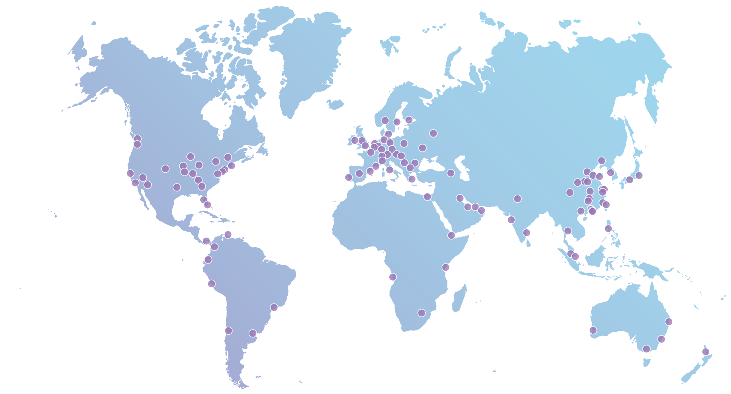
Cloudflare’s anycast network
10M
5M
HTTP requests/second
10%
150+
Internet requests
everyday
100+
Data centers globally
2.5M
1.2M
10M+
6M+
DNS requests/s
Websites, apps & APIs in 150 countries
Notes:
The only thing here that did not gow is 10% number, which has not the most scientific origins. It depends on what you call internet requests.
Otherwise we doubled our requests per seconds for both HTTP and DNS. DNS doesn’t include public resolver we did not have last year, which did grow by a factor of positive infinity.
We’re now at 150 datacenters instead of 100 one year ago and plan to cross 200 soon. Each of those needs monitoring and that’s what we use Prometheus for.

Slide 7
Cloudflare’s Prometheus deployment
85K
72K
Samples ingested per
server max
267
185
9.0M
Prometheus servers currently in production
4.6M
5
Time-series
max per server
4
420GB
250GB
Top-level
Prometheus servers
Max size of
data on disk
Notes:
Our global Prometheus deployment grew along with our edge network. The numbers here are per prometheus, not global.
We are very much looking forward to having Thanos to keep this in check with longer retention.

Slide 8
But this is a talk about an exporter
Notes:
That’s all great, but it’s not what I wanted to talk about here. I wanted to tell you about an exporter. Let’s first have a look at what we have now.

Slide 9


Two main options to collect system metrics
node_exporter
Gauges and counters for system metrics with lots of plugins:
cpu, diskstats, edac, filesystem, loadavg, meminfo, netdev, etc
cAdvisor
Gauges and counters for container level metrics:
cpu, memory, io, net, delay accounting, etc.
Check out this issue about Prometheus friendliness.
Notes:
There are two main exporters one can use to get some insight into a linux system performance.
The first one is node_exporter that gives you information about basics like CPU usage breakdown by type, memory usage, disk IO stats, filesystem and network usage.
The second one is cAdvisor, that gives similar metrics, but drills down to a container level. Instead of seeing total CPU usage you can see which containers (and systemd units are also containers for cAdvisor) use how much of global resources.
This is the absolute minimum of what you should know about your systems. If you don’t have these two, you should start there.
Let’s look at the graphs you can get out of this.

Slide 10
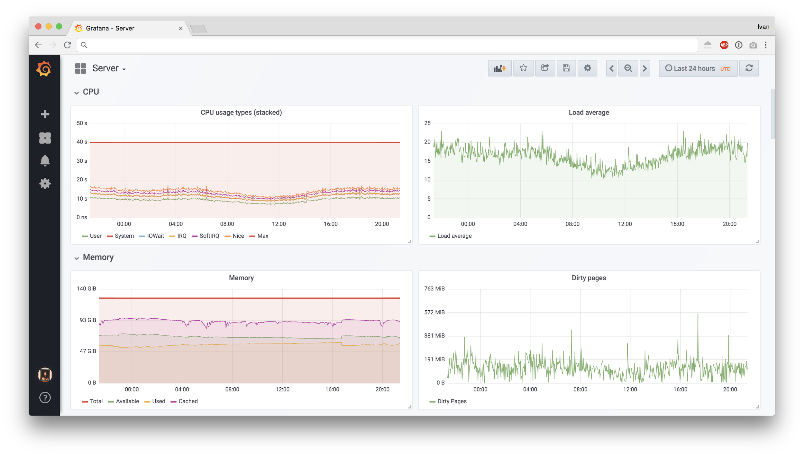
Example graphs from node_exporter
Notes:
I should mention that every screenshot in this talk is from a real production machine doing something useful, but we have different generations, so don’t try to draw any conclusions.
Here you can see the basics you get from node_exporter for CPU and memory. You can see the utilization and how much slack resources you have.

Slide 11
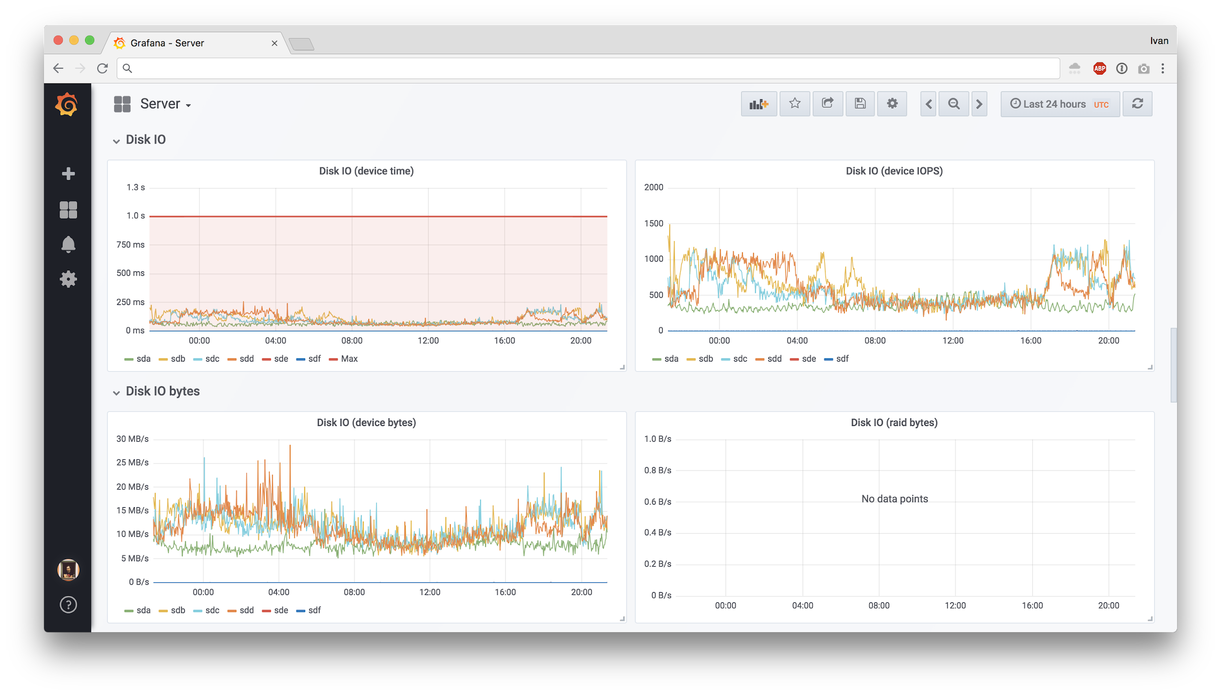
Example graphs from node_exporter
Notes:
Some more metrics from node_exporter, this time for disk IO. There are similar panels for network as well.
At the basic level you can do some correlation to explain why CPU went up if you see higher network and disk activity.

Slide 12
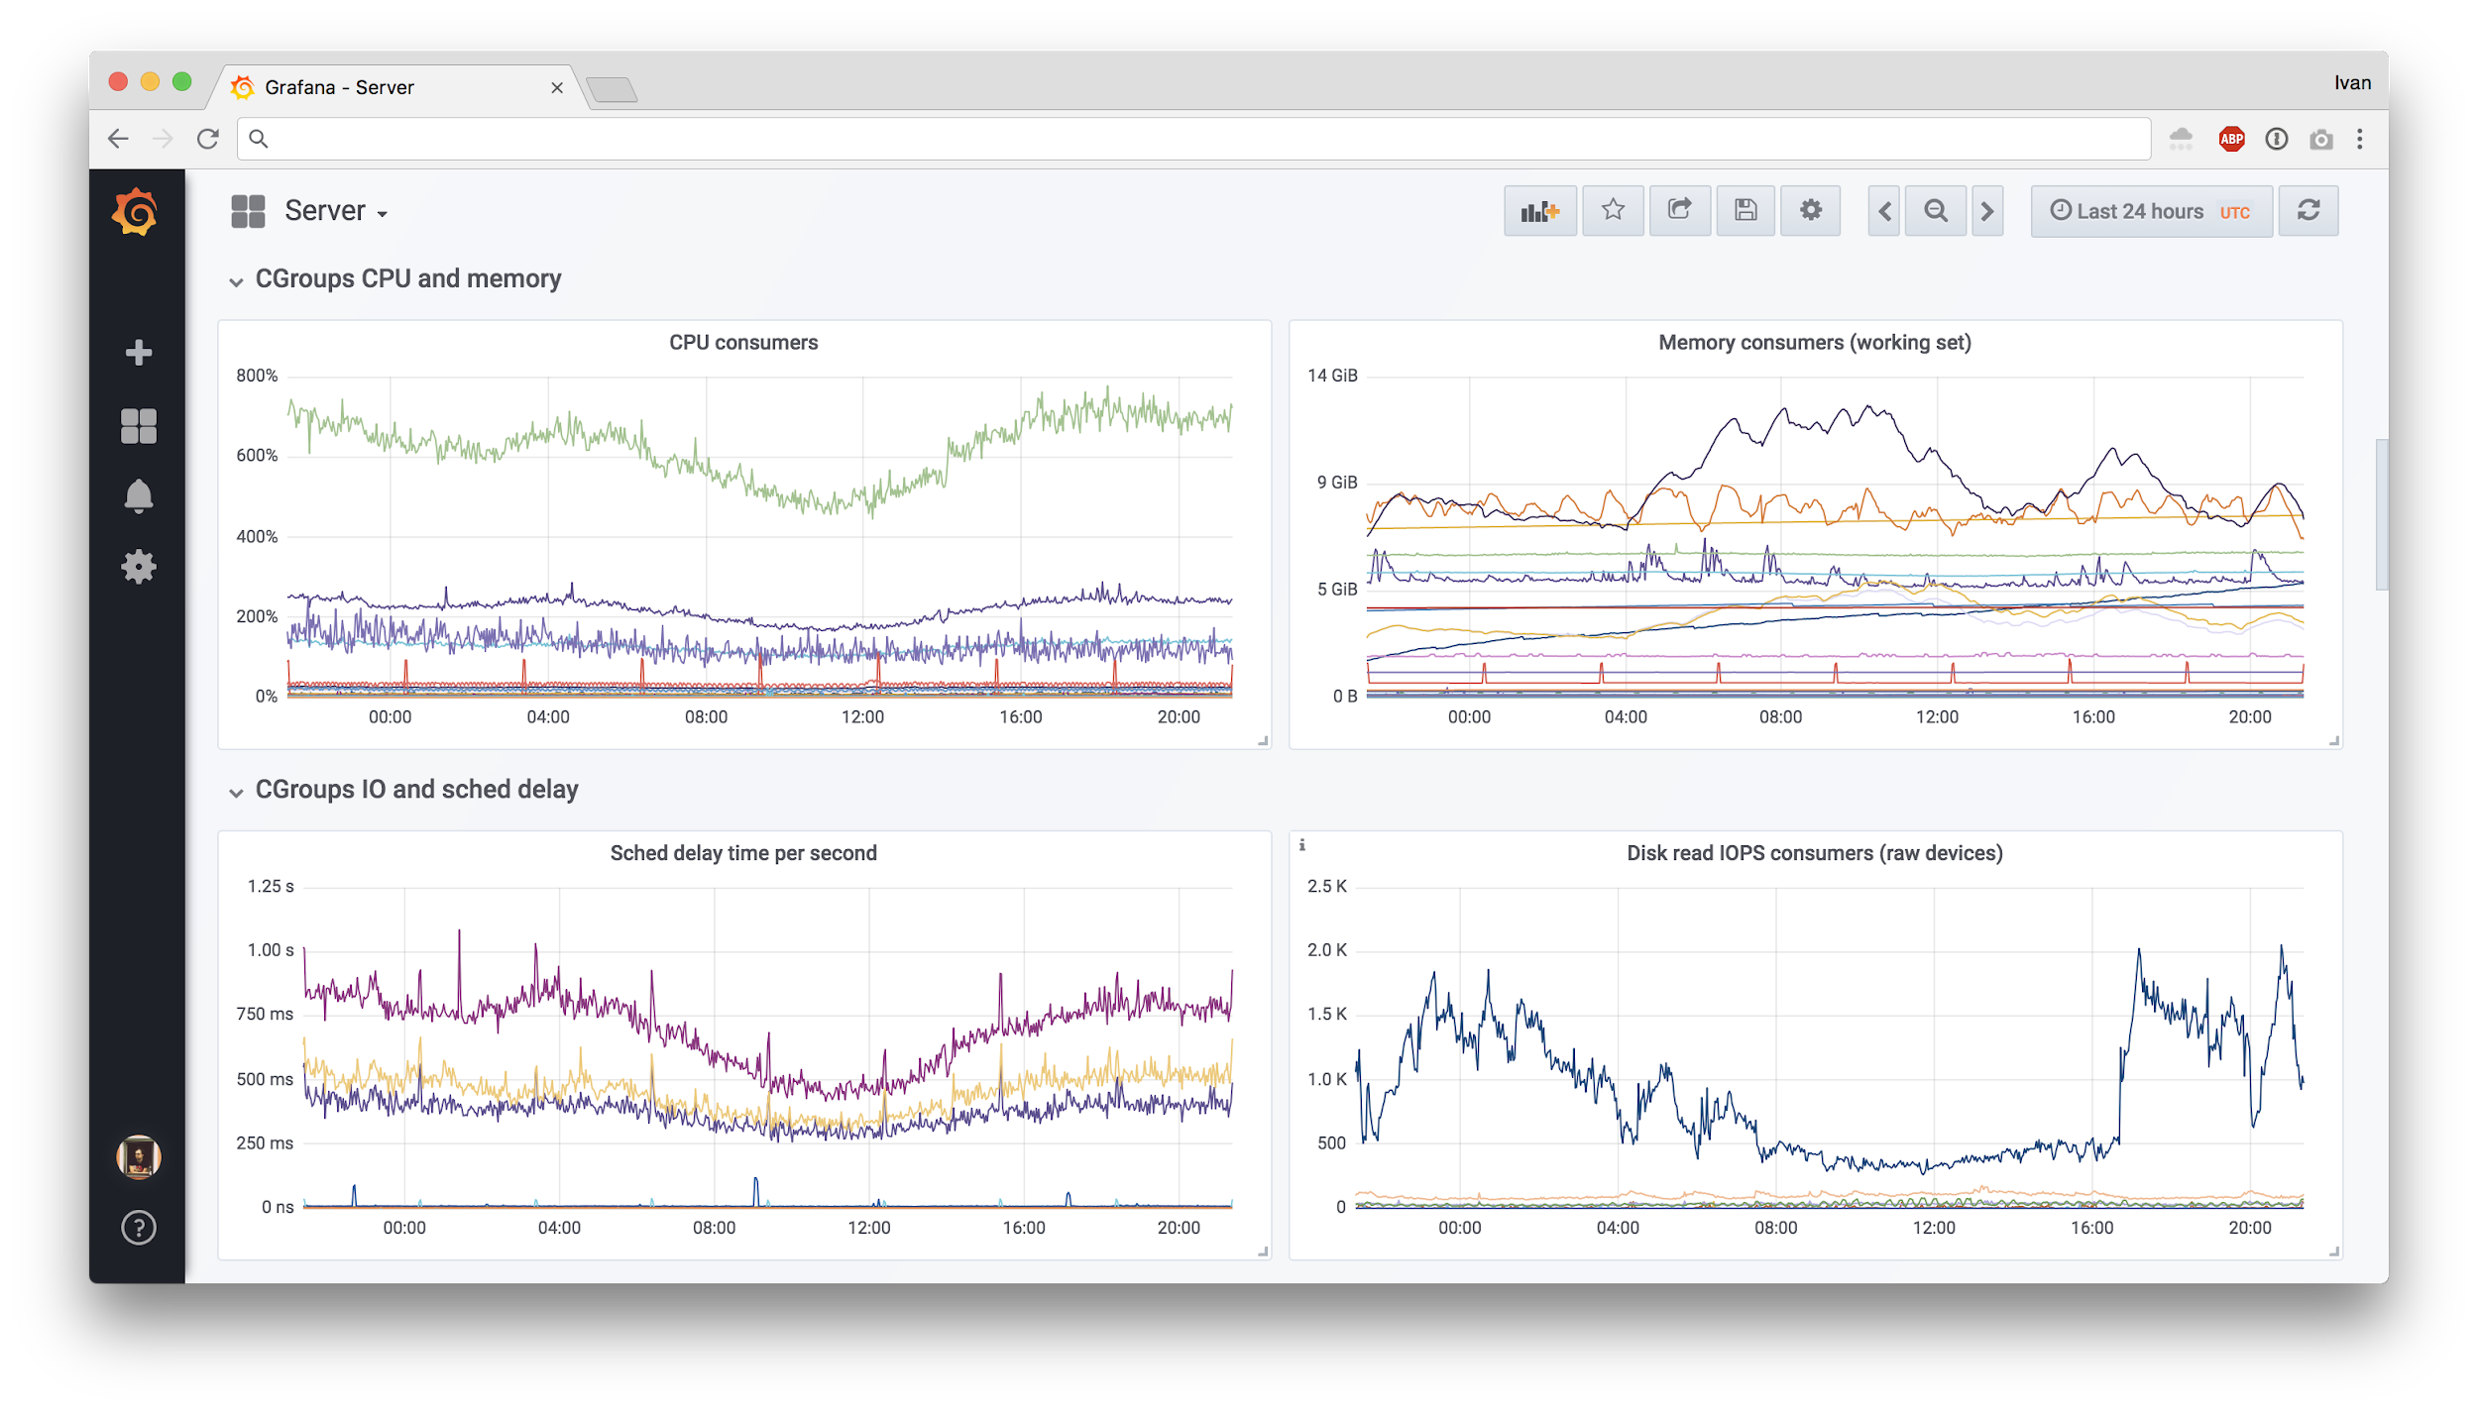
Example graphs from cAdvisor
Notes:
With cAdvisor this gets more interesting, since you can now see how global resources like CPU are sliced between services. If CPU or memory usage grows, you can pinpoint exact service that is responsible and you can also see how it affects other services.
If global CPU numbers do not change, you can still see shifts between services.
All of this information comes from the simplest counters.

Slide 13
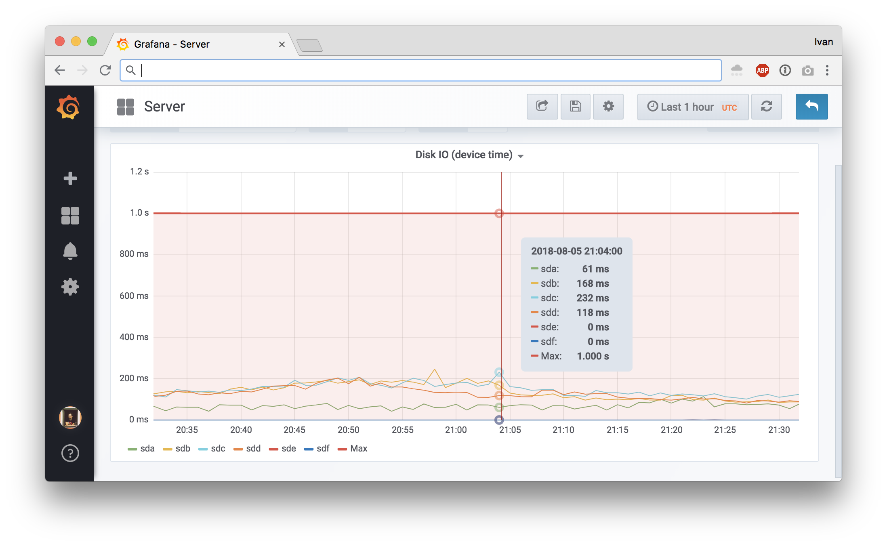
Counters are easy, but lack detail: e.g. IO
What’s the distribution?
Many fast IOs?
Few slow IOs?
Some kind of mix?
Read vs write speed?
Notes:
Counters are great, but they lack detail about individual events. Let’s take disk io for example. We get device io time from node_exporter and the derivative of that cannot go beyond one second per one second of real time, so we can draw a bold red line and see what kind of utilization we get from our disks.
We get one number that characterizes out workload, but that’s simply not enough to understand it. Are we doing many fast IO operations? Are we doing few slow ones? What kind of mix of slow vs fast do we get?

Slide 14
Histograms to the rescue
Counter:
node_disk_io_time_ms{instance="foo", device="sdc"} 39251489
Histogram:
bio_latency_seconds_bucket{instance="foo", device="sdc", le="+Inf"} 53516704
bio_latency_seconds_bucket{instance="foo", device="sdc", le="67.108864"} 53516704
...
bio_latency_seconds_bucket{instance="foo", device="sdc", le="0.001024"} 51574285
bio_latency_seconds_bucket{instance="foo", device="sdc", le="0.000512"} 46825073
bio_latency_seconds_bucket{instance="foo", device="sdc", le="0.000256"} 33208881
bio_latency_seconds_bucket{instance="foo", device="sdc", le="0.000128"} 9037907
bio_latency_seconds_bucket{instance="foo", device="sdc", le="6.4e-05"} 239629
bio_latency_seconds_bucket{instance="foo", device="sdc", le="3.2e-05"} 132
bio_latency_seconds_bucket{instance="foo", device="sdc", le="1.6e-05"} 42
bio_latency_seconds_bucket{instance="foo", device="sdc", le="8e-06"} 29
bio_latency_seconds_bucket{instance="foo", device="sdc", le="4e-06"} 2
bio_latency_seconds_bucket{instance="foo", device="sdc", le="2e-06"} 0
Notes:
These questions beg for a histogram. What we have is a counter above, but what we want is a histogram below.
Keep in mind that Prometheus histograms are inclusive, “le” label counts all events lower than or equal to the value.

Slide 15
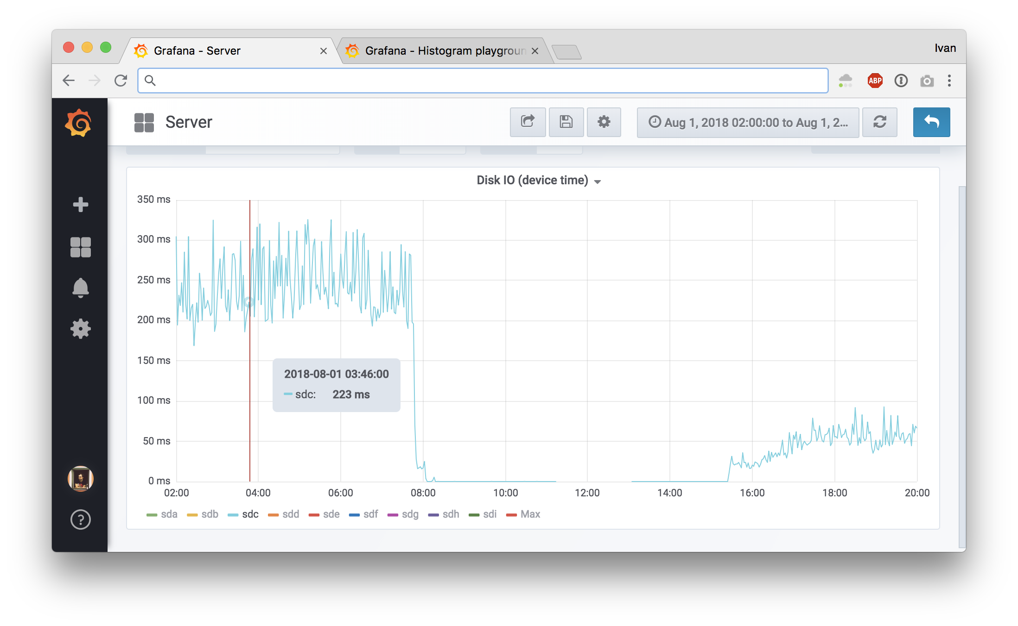
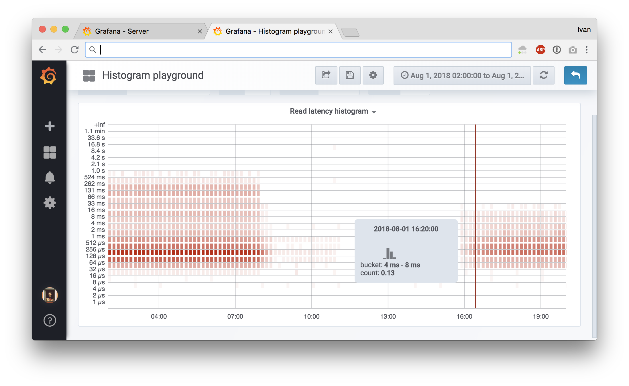
Can be nicely visualized with new Grafana
Disk upgrade in production
Notes:
Okay, so we have that histogram. To visualize the difference you get between the two metrics here are two screenshots of the same event, which is an SSD replacement in production. We replaced disk in production and this is how it affected line and the histogram. In the new Grafana 5 you can plot histograms as heatmaps and it gives you a lot more detail than just one line.
The next slide has a bigger screenshot, on this slide you should just see the shift in detail.

Slide 16
Larger view to see in detail
Notes:
Here you can see buckets color coded and each timeslot has its own distribution in a tooltip. It can definitely be better with bar highlights and double Y axis, but it’s a big step forward from just one line nonetheless.
In addition to nice visualizations, you can also plot number of events above Xms and have alerts and SLOs on that.

Slide 17
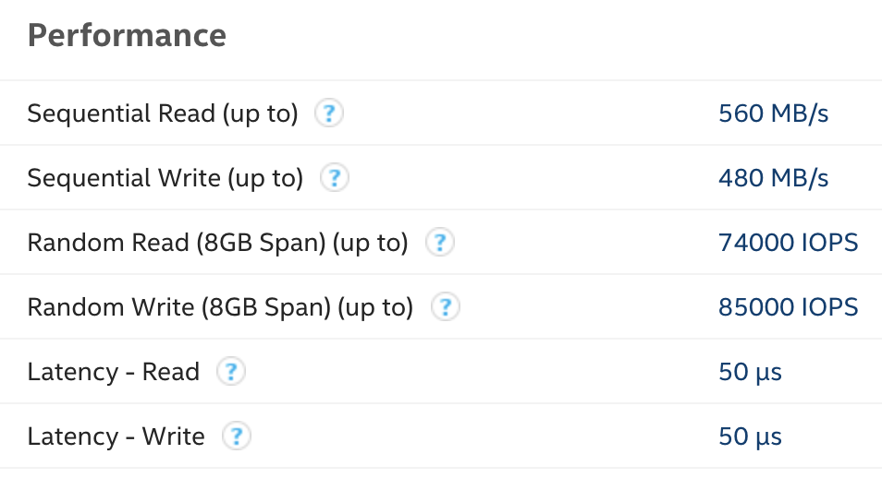
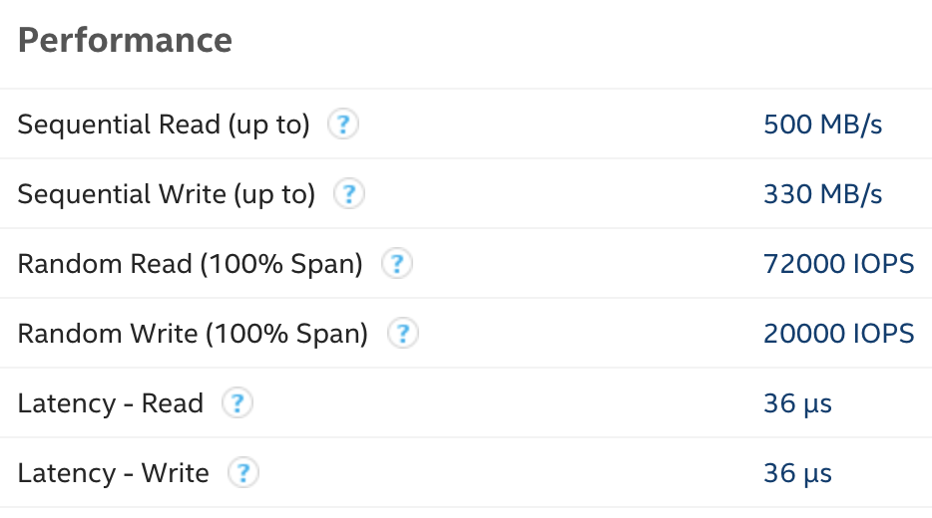
So much for holding up to spec
Notes:
And if you were looking closely at these histograms, you may have noticed values on the Y axis are kind of high. Before the replacement you can see values in 0.5s to 1.0s bucket.
Tech specs for the left disk give you 50 microsecond read/write latency and on the right you get a slight decrease to 36 microseconds. That’s not what we see on the histogram at all. Sometimes you can spot this with fio in testing, but production workloads may have patterns that are difficult to replicate and have very different characteristics. Histograms show how how it is.
By now you should be convinced that histograms are clearly superior for events where you care about timings of individual events.

Slide 18
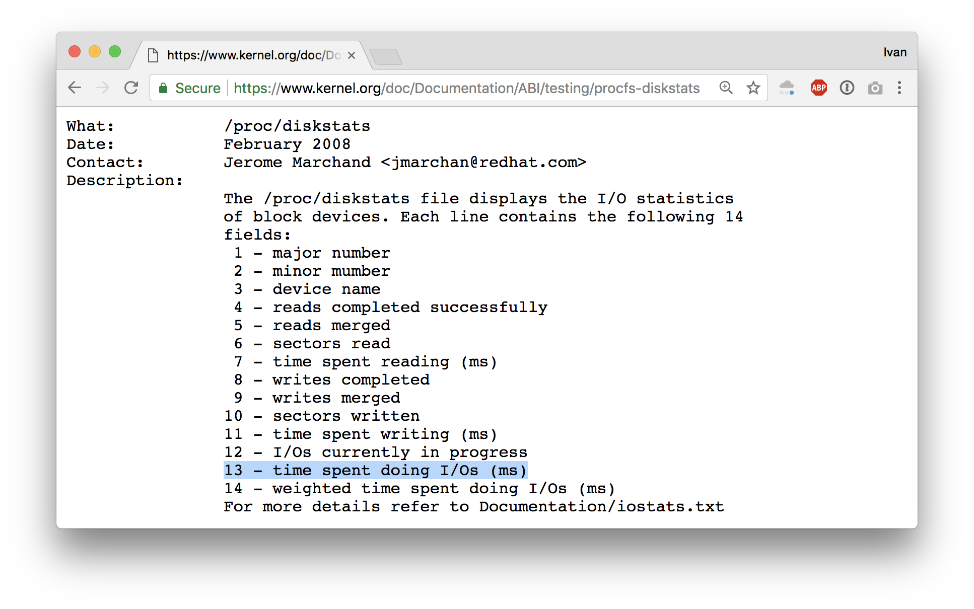
Linux kernel only gives you counters
Notes:
And if you wanted to switch all your storage latency measurements to histograms, I have tough news for you: linux kernel only provides counters for node_exporter.
You can try to mess with blktrace for this, but it doesn’t seem practical or efficient.
Let’s switch gears a little and see how summary stats from counters can be deceiving.

Slide 19

Autodesk research: Datasaurus (animated)
Notes:
This is a research from Autodesk. The creature on the left is called Datasaurus. Then there are target figures in the middle and animations on the right.
The amazing part is that shapes on the right and all intermediate animation frames for them have the same values for mean and standard deviation for both X and Y axis.
From summary statistic’s point of view it’s all the same, but if you plot individual events, a different picture emerges.

Slide 20
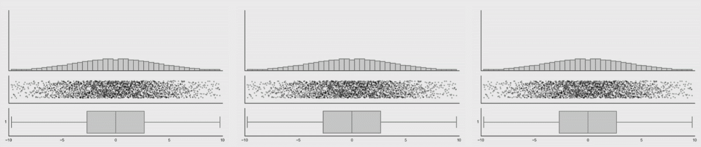
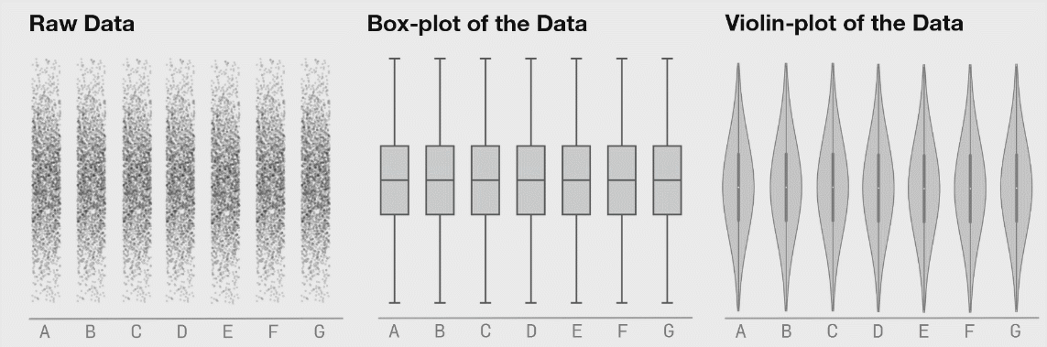
Autodesk research: Datasaurus (animated)
Notes:
This is from the same research, here you can clearly see how box plots (mean + stddev) are non-representative of the raw events.
Histograms, on the contrary, give an accurate picture.

Slide 21
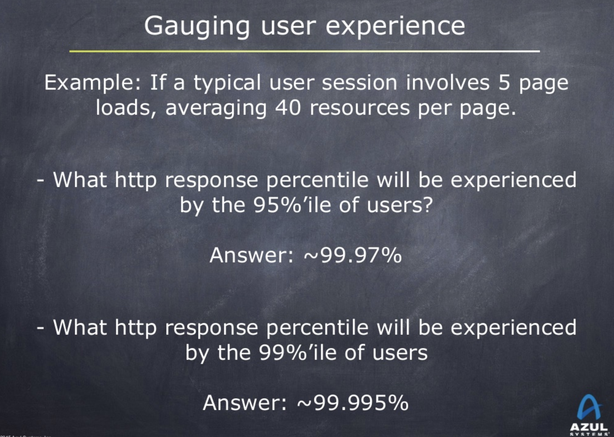
Gil Tene: How to Not Measure Latency
Notes:
Then there’s also this great talk about how to not measure latency. I picked just one slide to illustrate how percentiles of individual events should not be used to assess overall experience. Modern websites have many resources and this shows how many individual assets push nines into what you should care about.
There are a few variations of this talk. While it mainly focuses on JVM performance, it’s also a great source of ideas on general latency measurements.
Here we switch from averages to percentiles, but even with them some misconceptions are very common. This part is not strictly related to my talk, but I love referencing Gil’s slides, just because they are great.
Anyway, let’s get back to the point.

Slide 22
You need individual events for histograms
Solution has to be low overhead (no blktrace)
Solution has to be universal (not just IO tracing)
Solution has to be supported out of the box (no modules or patches)
Solution has to be safe (no kernel crashes or loops)
Notes:
We established that histograms is what you want. You need individual events to make those histograms. What are the requirements for a system that would handle it, assuming that we want to measure things like io operations in the linux kernel?
* It has to be low overhead, otherwise we can’t run it in production because of cost
* It has to be universal, so we are not locked into just io tracing — there are plenty of interesting things to measure in linux kernel
* It has to be supported out of the box, third party kernel modules and patches are not very practical
* And finally it has to be safe, we don’t want to crash large chunk of the internet for metrics

Slide 23
Enter eBPF
Low overhead sandboxed user-defined bytecode running in kernel.
It can never crash, hang or interfere with the kernel negatively.
If you run Linux 4.1 (June 2015) or newer, you already have it.
Great intro from Brendan Gregg: http://www.brendangregg.com/ebpf.html
BPF and XDP reference: https://cilium.readthedocs.io/en/v1.1/bpf/
Notes:
And it turns out, there’s a solution called eBPF. It’s a low overhead sandboxed user-defined bytecode running in the kernel. It can never crash, hang or interfere with the kernel negatively. That’s kinda vague, but here are two links that dive into the details explaining how this works.
The main part is that it’s already included with the linux kernel. It’s used in networking subsystem and things like seccomp rules, but as a general “run safe code in the kernel” it has many uses beyond that. I think sysdig is going to support as a backed now too.

Slide 24
It’s a bytecode you don’t have to write
0: 79 12 20 00 00 00 00 00 r2 = *(u64 *)(r1 + 32)
1: 15 02 03 00 57 00 00 00 if r2 == 87 goto +3
2: b7 02 00 00 00 00 00 00 r2 = 0
3: 79 11 28 00 00 00 00 00 r1 = *(u64 *)(r1 + 40)
4: 55 01 01 00 57 00 00 00 if r1 != 87 goto +1
5: b7 02 00 00 01 00 00 00 r2 = 1
6: 7b 2a f8 ff 00 00 00 00 *(u64 *)(r10 - 8) = r2
7: 18 11 00 00 03 00 00 00 00 00 00 00 00 00 00 00 ld_pseudo r1, 1, 3
9: bf a2 00 00 00 00 00 00 r2 = r10
10: 07 02 00 00 f8 ff ff ff r2 += -8
11: 85 00 00 00 01 00 00 00 call 1
12: 15 00 04 00 00 00 00 00 if r0 == 0 goto +4
13: 79 01 00 00 00 00 00 00 r1 = *(u64 *)(r0 + 0)
14: 07 01 00 00 01 00 00 00 r1 += 1
15: 7b 10 00 00 00 00 00 00 *(u64 *)(r0 + 0) = r1
16: 05 00 0a 00 00 00 00 00 goto +10
17: b7 01 00 00 01 00 00 00 r1 = 1
18: 7b 1a f0 ff 00 00 00 00 *(u64 *)(r10 - 16) = r1
Notes:
The previous slide said it’s a bytecode. This is how it looks. The good part is that you never have to write this by hand.

Slide 25
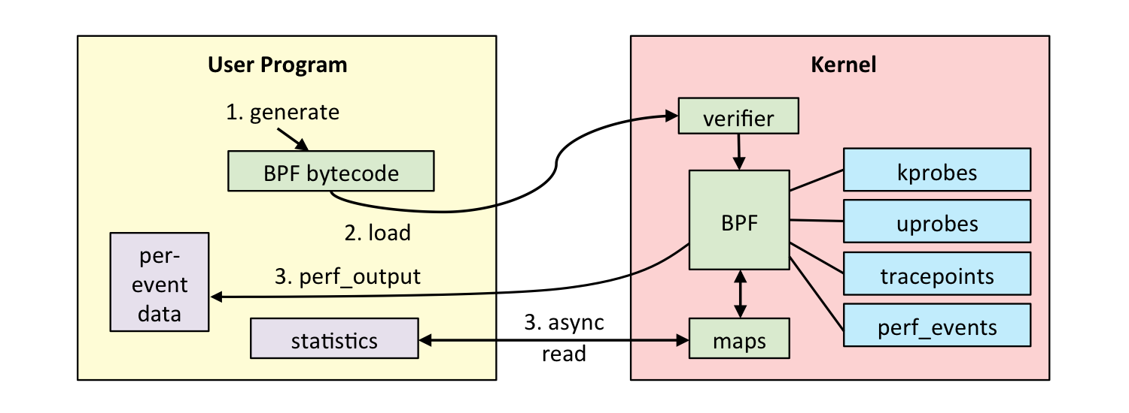
eBPF in a nutshell
You can write small C programs that attach to kernel functions
  Max 4096 instructions, 512B stack, in-kernel JIT for opcodes
  Verified and guaranteed to terminate
  No crossing of kernel / user space boundary
You can use maps to share data with these programs (extract metrics)
Notes:
To use eBPF you write small C programs that attach to kernel functions and run before or after them. Your C code is then compiled into bytecode, verified and loaded into kernel to run with JIT compiler for translation into native opcodes. The constraints on the code are enforced by verifier and you are guaranteed to not be able to write an infinite loop or allocate tons of memory.
To share data with eBPF programs, you can use maps. In terms of metric collection, maps are updated by eBPF programs in the kernel and only accessed by userspace during scraping.
It is critical for performance that the eBPF VM runs in the kernel and does not cross userspace boundary.
You can see the workflow on the image here.
Having to write C is no a eBPF constraint, you can produce bytecode in any way you want. There are other alternatives like lua and ply, and sysdig is adding a backed to run via eBPF too. Maybe someday people will be writing safe javacript that runs in the kernel.

Slide 26
BCC takes care of compiling C (dcstat)
int count_lookup(struct pt_regs *ctx) { // runs after d_lookup kernel function
struct key_t key = { .op = S_SLOW };
bpf_get_current_comm(&key.command, sizeof(key.command)); // helper function to get current command
counts.increment(&key); // update map you can read from userspace
if (PT_REGS_RC(ctx) == 0) {
key.op = S_MISS;
val = counts.increment(&key); // update another key if it’s a miss
}
return 0;
}
Notes:
Just like GCC compiles C code into machine code, BCC compiles C code into eBPF opcodes. BCC is a rewriter plus LLVM compiler and you can use it as a library in your code. There are bindings for C, C++, Python and Go.
In this example we have a simple function that runs after “d_lookup” kernel function that is responsible for directory cache lookups. It doesn’t look complicated and the basics should be understandable for people familiar with C-like languages.

Slide 27
BCC has bundled tools: biolatency
$ sudo /usr/share/bcc/tools/biolatency
Tracing block device I/O... Hit Ctrl-C to end.
^C
usecs : count distribution
0 -> 1 : 0 | |
2 -> 3 : 0 | |
4 -> 7 : 0 | |
8 -> 15 : 0 | |
16 -> 31 : 3 | |
32 -> 63 : 14 |* |
64 -> 127 : 107 |******** |
128 -> 255 : 525 |****************************************|
256 -> 511 : 68 |***** |
512 -> 1023 : 10 | |
Notes:
In addition to a compiler, BCC includes some tools that can be used for debugging production systems with low overhead eBPF provides.
Let’s quickly go over a few of them.
This is biolatency, it show you a histogram of disk io operations. That’s exactly what we started with and it’s already available, just as a script instead of an exporter.

Slide 28
BCC has bundled tools: execsnoop
# execsnoop
PCOMM PID RET ARGS
bash 15887 0 /usr/bin/man ls
preconv 15894 0 /usr/bin/preconv -e UTF-8
man 15896 0 /usr/bin/tbl
man 15897 0 /usr/bin/nroff -mandoc -rLL=169n -rLT=169n -Tutf8
man 15898 0 /usr/bin/pager -s
nroff 15900 0 /usr/bin/locale charmap
nroff 15901 0 /usr/bin/groff -mtty-char -Tutf8 -mandoc -rLL=169n -rLT=169n
groff 15902 0 /usr/bin/troff -mtty-char -mandoc -rLL=169n -rLT=169n -Tutf8
groff 15903 0 /usr/bin/grotty
Notes:
Here’s execsnoop, that allows you to see which commands are being launched in the system. This is often useful if you want to catch quickly terminating programs that do not hang around long enough to be observed in ps output.

Slide 29
BCC has bundled tools: ext4slower
# ext4slower 1
Tracing ext4 operations slower than 1 ms
TIME COMM PID T BYTES OFF_KB LAT(ms) FILENAME
06:49:17 bash 3616 R 128 0 7.75 cksum
06:49:17 cksum 3616 R 39552 0 1.34 [
06:49:17 cksum 3616 R 96 0 5.36 2to3-2.7
06:49:17 cksum 3616 R 96 0 14.94 2to3-3.4
06:49:17 cksum 3616 R 10320 0 6.82 411toppm
06:49:17 cksum 3616 R 65536 0 4.01 a2p
06:49:17 cksum 3616 R 55400 0 8.77 ab
06:49:17 cksum 3616 R 36792 0 16.34 aclocal-1.14
06:49:17 cksum 3616 R 15008 0 19.31 acpi_listen
06:49:17 cksum 3616 R 6123 0 17.23 add-apt-repository
06:49:17 cksum 3616 R 6280 0 18.40 addpart
Notes:
There’s also ext4slower that instead of showing slow IO operations, shows slow ext4 filesystem operations. One might think these two map fairly closely, but one filesystem operation does not necessarily map to one disk IO operation:
* Writes can go into writeback cache and not touch the disk until later
* Reads can involve multiple IOs to the physical device
* Reads can also be blocked behind async writes
The more you know about disk io, the more you want to run stateless, really.

Slide 30
Making use of all that with ebpf_exporter
Many BCC tools make sense as metrics, so let’s use that
Exporter compiles user-defined BCC programs and loads them
Programs run in the kernel and populate maps
During scrape exporter pulls all maps and transforms them:
  Map keys to labels (disk name, function name, cpu number)
  Map values to metric values
  There are no float values in eBPF
Notes:
Okay, now to the main idea of this talk. We have all these primitives, now we should be able to tie them all together and get an exporter on our hands to get metrics in Prometheus where they belong. Many BCC tools already have kernel side ready and reviewed by smart people, so the hardest part is covered.
The idea is simple:
* We compile BCC programs and load them with the exporter
* Programs run in the kernel and collect metrics into maps
* During scrape we pull maps from the kernel and transform them into prometheus metrics
* Map keys need to be mapped to labels with some transformations
* Map values to need to be just converted to float64

Slide 31
Getting timer counters into Prometheus
code: |
BPF_HASH(counts, u64);
// Generates tracepoint__timer__timer_start
TRACEPOINT_PROBE(timer, timer_start) {
counts.increment((u64) args->function);
return 0;
}
metrics:
counters:
- name: timer_start_total
help: Timers fired in the kernel
table: counts
labels:
- name: function
size: 8
decoders:
- name: ksym
tracepoints:
timer:timer_start: tracepoint__timer__timer_start
Code to run in the kernel
and populate the map
How to turn map into metrics
readable by Prometheus
Notes:
Let’s look at a simple example to get counters for timers fired in the kernel. This example is from an ebpf_exporter repo, where you can find a few more complex ones.
On the BCC code side we define a hash and attach to a tracepoint. When tracepoint fires, we increment our hash where the key is the address of a function that fired the tracepoint.
On the exporter side we say that we want to take the hash and transform 8 byte keys with “ksym” decoder. Kernel keeps a map of function addresses to their names in /proc/kallsyms and we just use that. We also define that we want to attach our function to “timer:timer_start” tracepoint.
This is objectively quite verbose and perhaps some things can be inferred instead of being explicit.

Slide 32
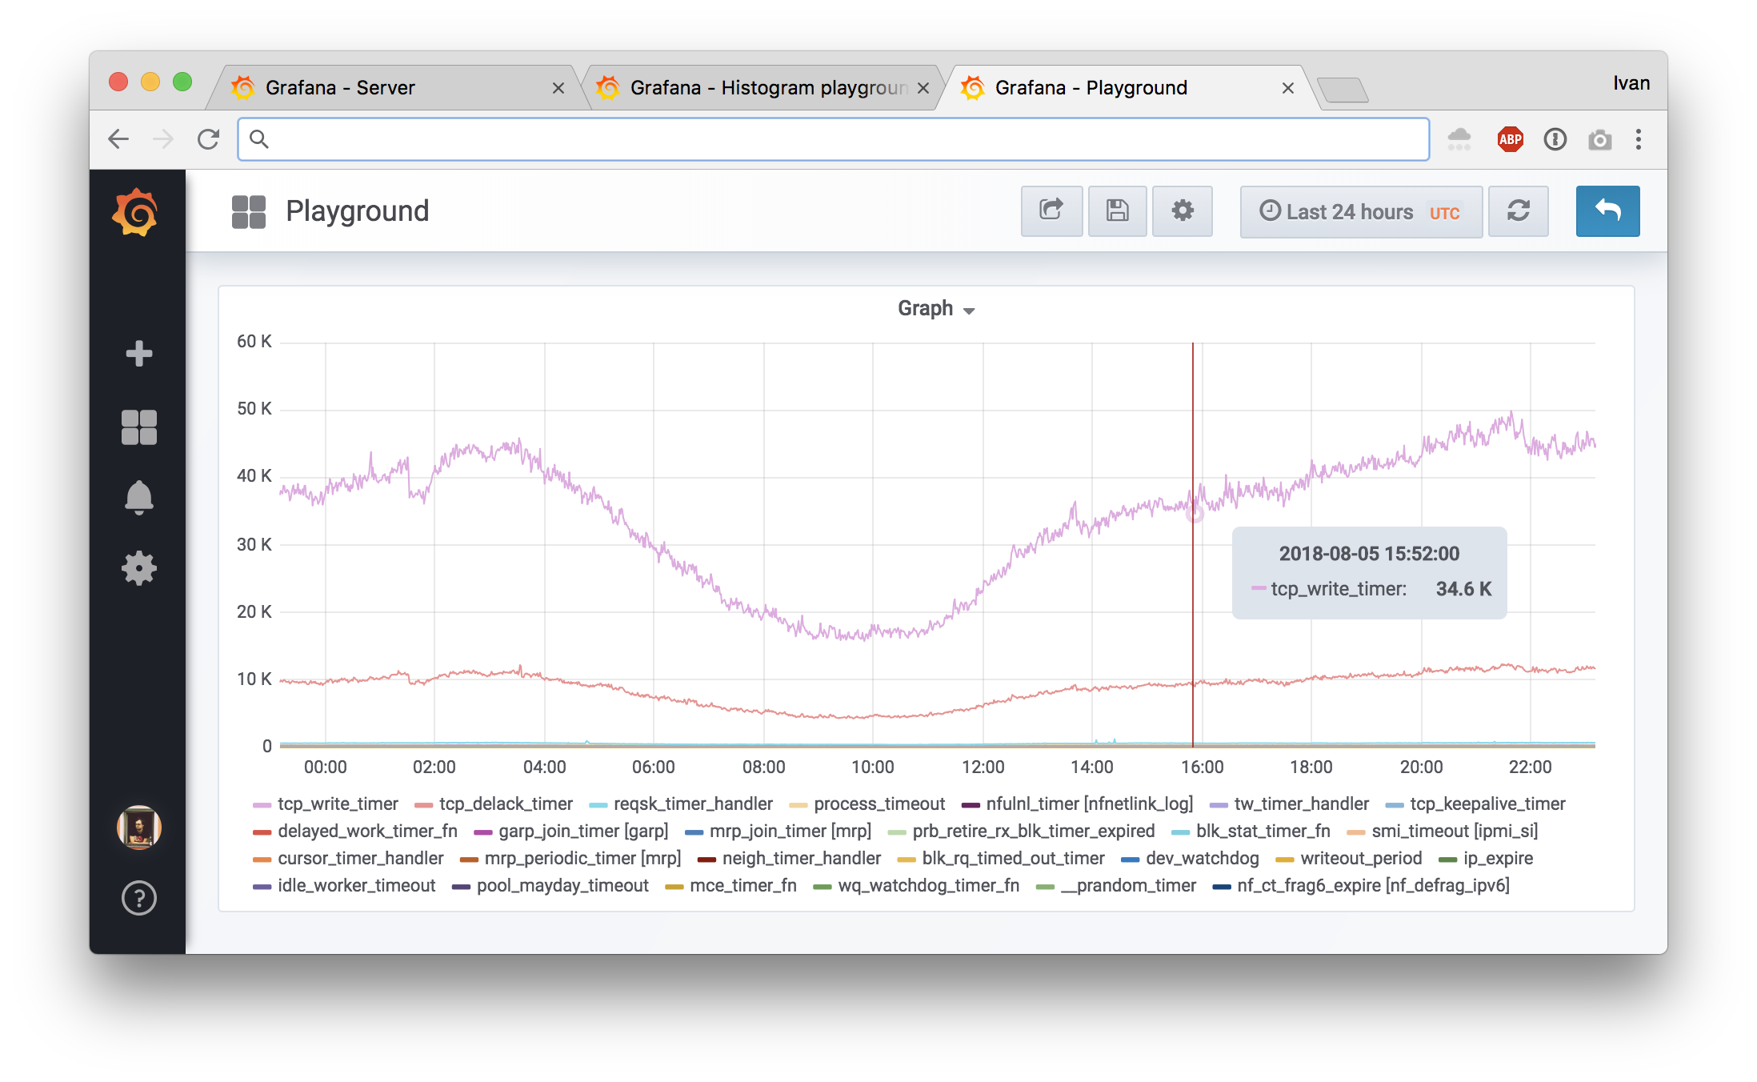
Getting timer counters into Prometheus
Notes:
This is an example graph we can get out of this exporter config.

Slide 33
Why can timers be useful?
See Cloudflare blog post: “Tracing System CPU on Debian Stretch”.
TL;DR: Debian upgrade triggered systemd bug where it broke TCP segmentation offload, which increased CPU load 5x and introduced lots of interesting side effects up to memory allocation stalls.
If we had timer metrics enabled, we would have seen this sooner.
Notes:
Why can this be useful? Check out my post in the Cloudflare blog about our tracing of a weird bug during OS upgrade from Debian Jessie to Stretch.
TL;DR is that systemd bug broke TCP segmentation offload on vlan interface, which increased CPU load 5x and introduced lots of interesting side effects up to memory allocation stalls.
If we had timer metrics enabled, we would have seen the clear change in metrics sooner.

Slide 34
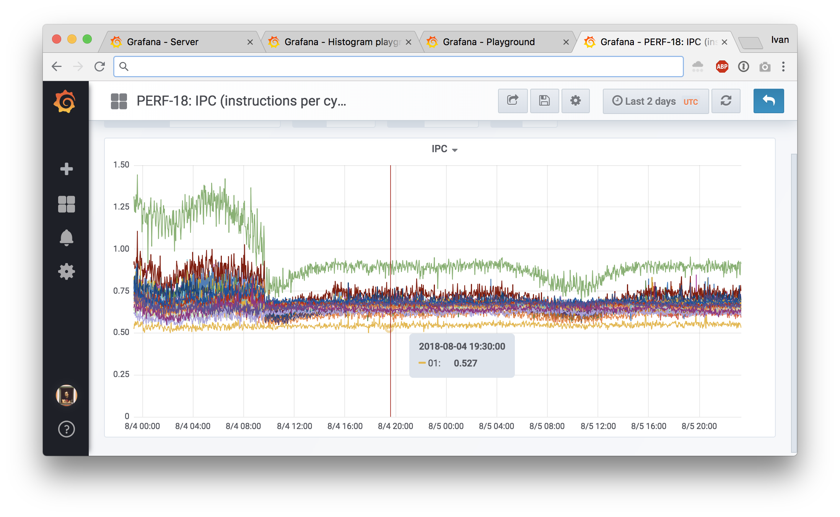
Other bundled examples: IPC
Notes:
Another bundled example can give you IPC or instruction per cycle metrics for each CPU. On this production system we can see a few interesting things:
* Not all cores are equal, with two cores being outliers (green on the top is zero, yellow on the bottom is one)
* Something happened that dropped IPC of what looks like half of cores
* There’s some variation in daily load cycles that affects IPC

Slide 35
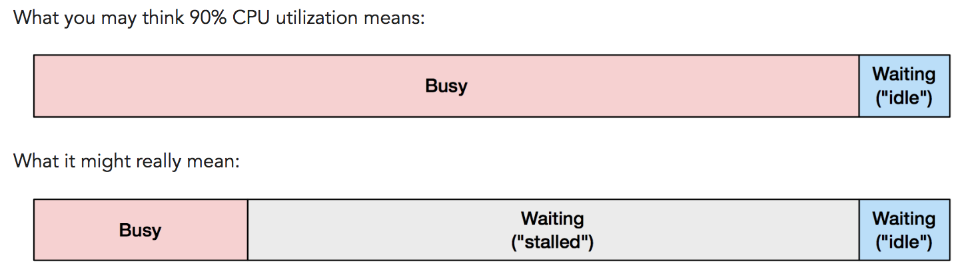
Why can instructions per cycle be useful?
See Brendan Gregg’s blog post: “CPU Utilization is Wrong”.
TL;DR: same CPU% may mean different throughput in terms of CPU work done. IPC helps to understand the workload better.
Notes:
Why can this be useful? Check out Brendan Gregg’s somewhat controversial blog post about CPU utilization.
TL;DR is that CPU% does not include memory stalls that do not perform any useful compute work. IPC helps to understand that factor better.

Slide 36
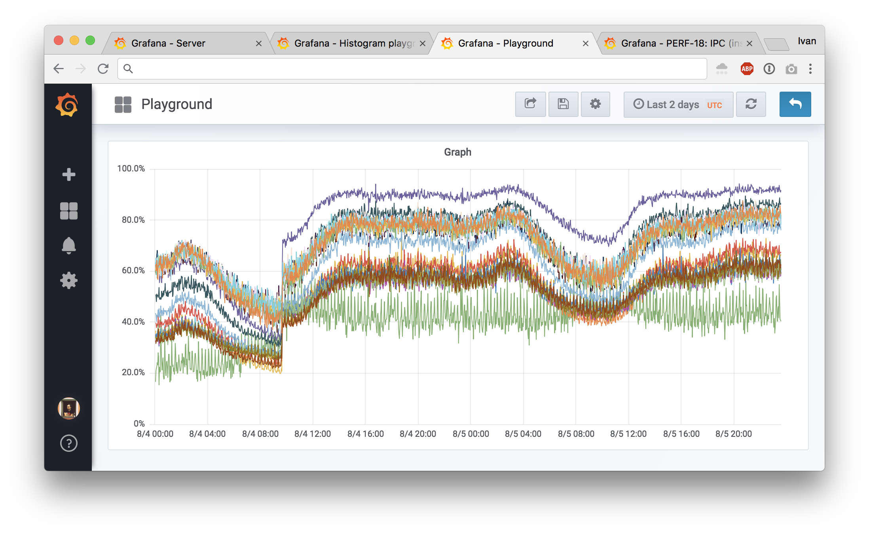
Other bundled examples: LLC (L3 Cache)
Notes:
Another bundled example is LLC or L3 CPU cache hit rate. This is from the same machine as IPC metrics and you can see some major affecting not just IPC, but also the hit rate.

Slide 37
Why can LLC hit rate be useful?
You can answer questions like:
Do I need to pay more for a CPU with bigger L3 cache?
How does having more cores affect my workload?
LLC hit rate usually follows IPC patterns as well.
Notes:
Why can this be useful? You can see how your CPU cache is doing and you can see how it may be affected by bigger cache or more cores sharing the same cache.
LLC hit rate usually goes hand in hand with IPC patterns as well.

Slide 38
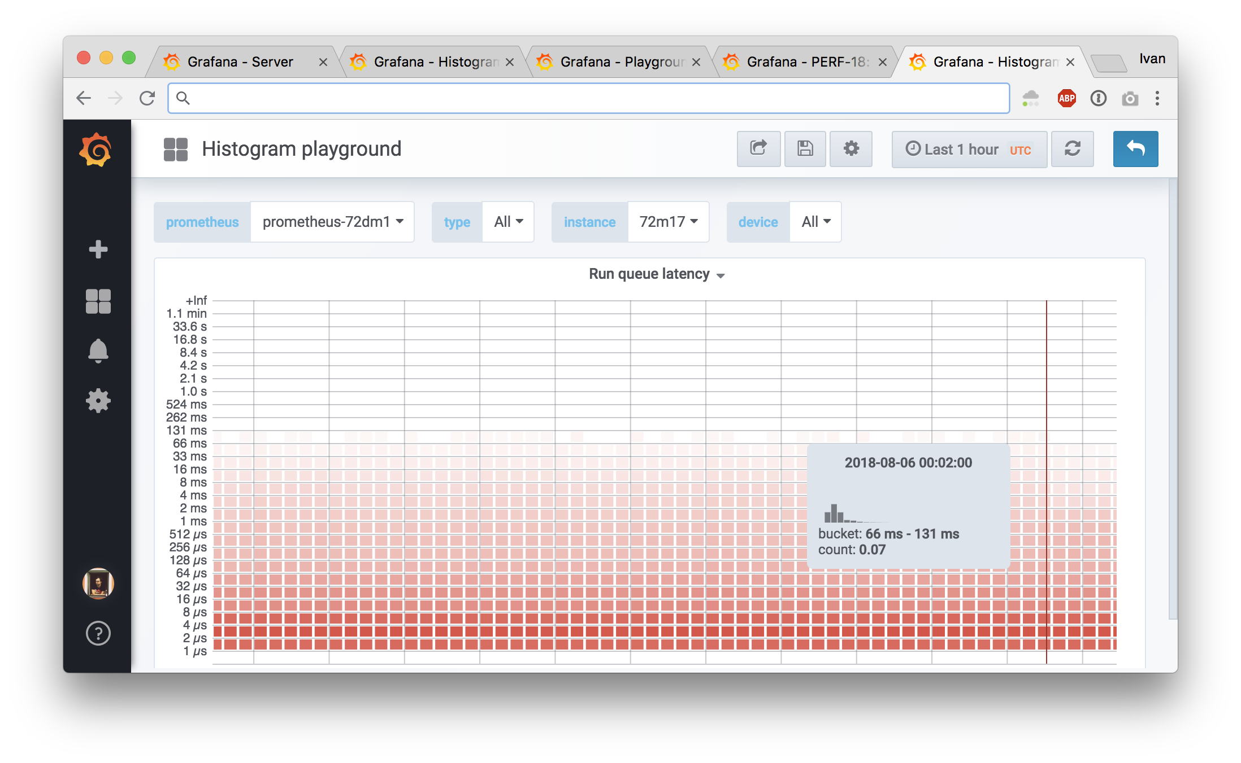
Other bundled examples: run queue delay
Notes:
Now to the fun part. We started with IO latency histograms and they are bundled with ebpf_exporter examples.
This is also a histogram, but now fow run queue latency. When a process is woken up in the kernel, it’s ready to run. If CPU is idle, it can run immediately and scheduling delay is zero. If CPU is busy doing some other work, the process is put on a run queue and the CPU picks it up when it’s available. That delay between being ready to run and actually running is the scheduling delay and it affects latency for interactive applications.
In cAdvisor you have a counter with this delay, here you have a histogram of actual values of that delay.

Slide 39
Why can run queue latency be useful?
See: “perf sched for Linux CPU scheduler analysis” by Brendan G.
You can see how contended your system is, how effective is the scheduler and how changing sysctls can affect that.
It’s surprising how high delay is by default.
From Scylla: “Reducing latency spikes by tuning the CPU scheduler”.
Notes:
Understanding of how you can be delayed is important for understanding the causes of externally visible latency. Check out another blog post by Brendan Gregg to see how you can further trace and understand scheduling delays with linux perf tool.
It also helps to have a metrics that you can observe if you change any scheduling sysctls in the kernel. You can never trust internet or even your own judgement to change any sysctls. If you can’t measure the effects, you are lying to yourself.
There’s also another great post from Scylla people about their finds. We were able to apply their sysctls and observe results, that was nice.
Things like pinning processes to CPUs also affects scheduling, so this metric is invaluable for such experiments.

Slide 40
How many things can you measure?
Numbers are from a production Cloudflare machine running Linux 4.14:
501 hardware events and counters:
  sudo perf list hw cache pmu | grep '^ [a-z]' | wc -l
1853 tracepoints:
  sudo perf list tracepoint | grep '^ [a-z]' | wc -l
Any non-inlined kernel function (there’s like a bazillion of them)
No support for USDT or uprobes yet
Notes:
The examples I gave are not the only ones possible. In addition to IPC and LLC metrics there are around 500 hardware metrics you can get on a typical server.
There are around 2000 tracepoints with stable ABI you can use on many kernel subsystems.
And you can always trace any non-inlined kernel function, but nobody guarantees binary compatibility between releases for those. Some are stable, others not so much.
We don’t have support for user user statically defined tracepoints or uprobes, which means you cannot trace userspace applications. This is something we can reconsider in the future, but in the meantime you can always add metrics to your apps by regular means.

Slide 41
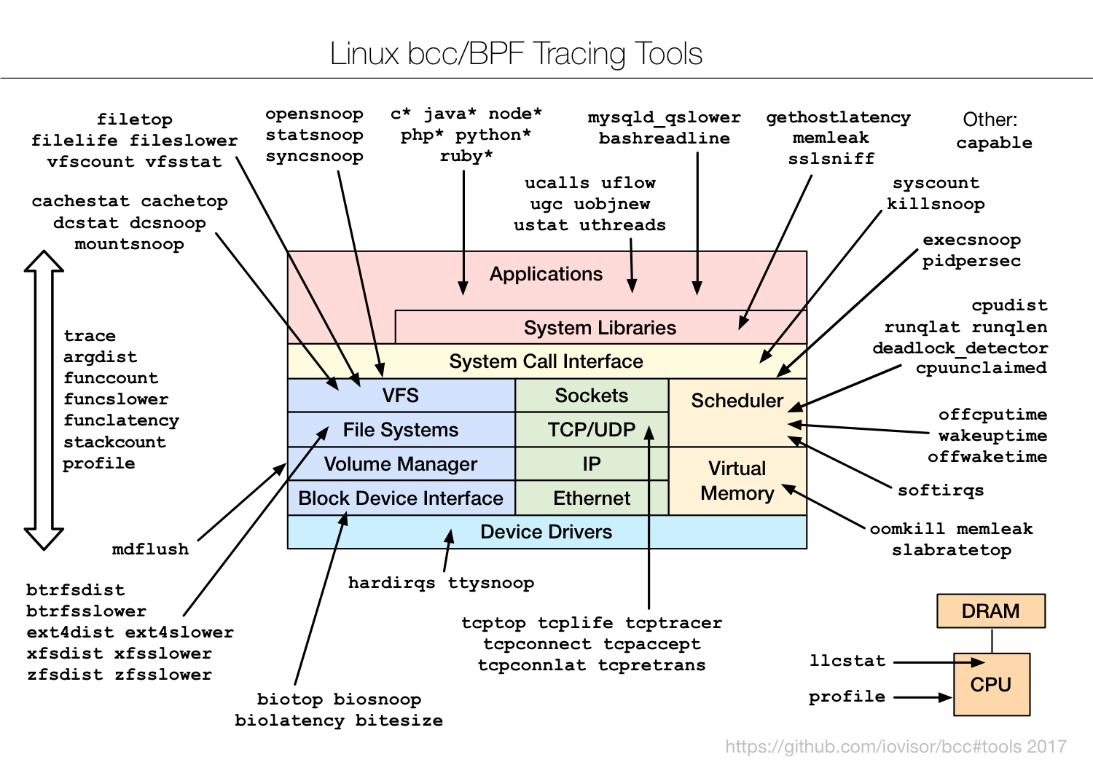
Tools bundled with BCC
Notes:
This image shows tools that BCC provides, you can see it covers many aspects.

Slide 42
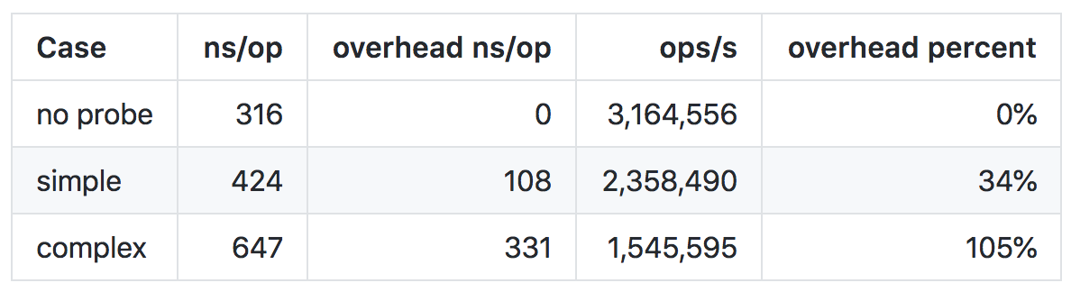
eBPF overhead numbers for kprobes
You should always measure yourself (system CPU is the metric).
Here’s what we’ve measured for getpid() syscall:
Notes:
Nothing in this life is free and even low overhead still means some overhead. You should measure this in your own environment, but this is what we’ve seen.
For a fast getpid() syscall you get around 34% overhead if you count them by pid. 34% sounds like a lot, but it’s the simplest syscall and 100ns overhead is a cost of one memory reference according to quick googling.
For complex case where we mix command name to copy some memory and mix in some randomness, the number jumps to 330ns or 105% overhead. We can still do 1.55M ops/s instead of 3.16M ops/s per logical core. If you measure something that doesn’t happen as often on each core, you’re probably not going to notice it.
We noticed run queue latency histogram to ad 300ms of system time on a machine with 40 logical cores and 250K scheduling events per second.
Your mileage may vary.

Slide 43
Where should you run ebpf_exporter
Anywhere where overhead is worth it.
Simple programs can run anywhere
Complex programs (run queue latency) can be gated to:
  Canary machines where you test upgrades
  Timeline around updates
At Cloudflare we do exactly this, except we use canary datacenters.
Notes:
So where should you run the exporter then? Anywhere you feel comfortable.
If you run simple programs, it doesn’t hurt to run anywhere. If you are concerned about overhead, you can do it only on canary instances and hope for results to be representative. We do exactly that, but instead of canary instances we have a luxury of having a couple of canary datacenters with live customers. They get updates after our offices do, so it’s not as bad as it sounds.
For some upgrade events you may want to enable more extensive metrics. An example would be a major distro or kernel upgrade.

Slide 44
Thank you
Run it: https://github.com/cloudflare/ebpf_exporter (there are docs!)
Reading materials on eBPF:
https://iovisor.github.io/bcc/
https://github.com/iovisor/bcc/blob/master/docs/reference_guide.md
http://www.brendangregg.com/ebpf.html
http://docs.cilium.io/en/latest/bpf/
Ivan on twitter: @ibobrik
Notes:
That is all the time I had. The exporter is open source and I encourage you to use it and maybe contribute an example if you use something in production.
Here are some reading materials if you want to learn about eBPF and superpowers it gives to the linux kernel.
Feel free to grab me later if you want to talk about the exporter, Cloudflare or anything.

Slide 45

Questions?
Notes:
Questions?

